Slide 1


[Social Buzz]

Slide 2


Today's agenda
Project recap
Problem
The Analytics team
Process
Insights
Summary

Slide 3

The Social Buzz Project is to
1. Audit Big Data Practices
2. Prepare for a Successful IPO
3. Analyze the
Top Content Categories
Project Recap

Slide 4

Problem
Rapid growth and highly unstructured data (over 100,000 pieces of content daily)
Can we analyze this data to identify the main content categories impacting the business?

Slide 5




Pheby Mahoney
(Data Analyst)
The Analytics team
Andrew Fleming
(Chief Technical Architect)
Marcus Rompton
(Senior Principle)

Slide 6
Process
1
Data Understanding
2
Data Extraction and Cleaning
3
Data Merging
4
Data Modelling
5
Data Visualization and Insights

Slide 7

Insights
16 unique reactions for the top content category
16 unique categories of content
The month with the most posts is MAY

Slide 8
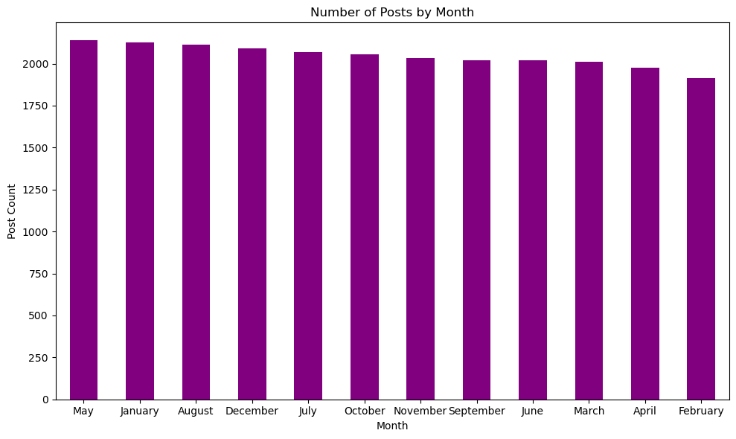

Slide 9
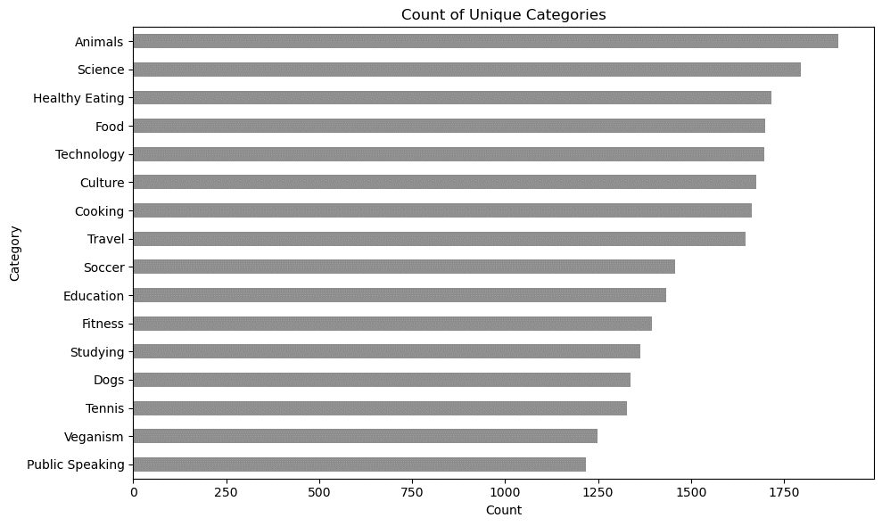
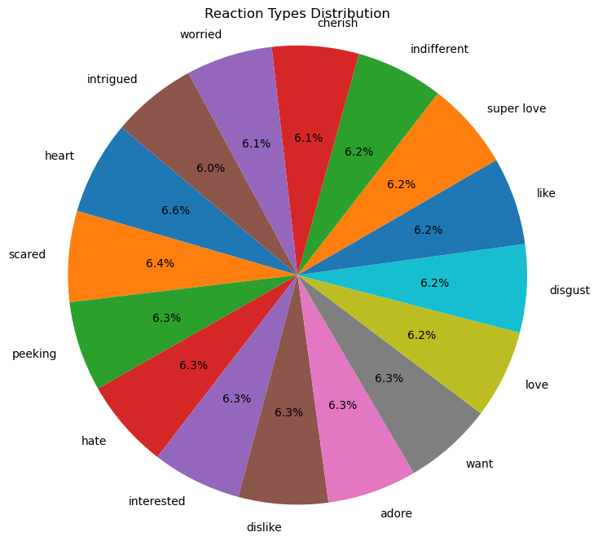
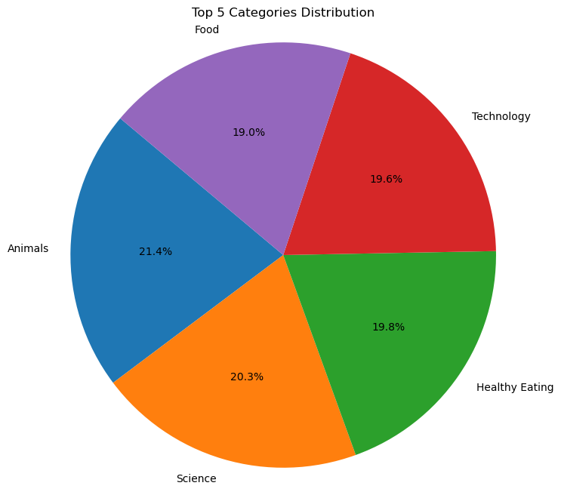

Slide 10

Top 5 Content Categories
Animals
Science
Healthy Eating
Technology
Food
Summary
Top 3 Reaction Types
Heart
Peeking
Scared
The Month with the most posts
- MAY

Slide 11
Thank you!
ANY QUESTIONS?

